Slide 1
Natural Language Processing Workshop
Session 1

Slide 2
Content
Exercise: Build your first bot
What is chatbot & Type of Chatbots
What is Rasa?
Review chatbot architecture

Slide 3
Exercise: 1
Build your first chatbot

Slide 4
Exercise: Chatbot to cheer you up
Open folder exercise-1
Follow the instructions

Slide 5
Chatbot & Type
What is chatbot & type of chatbot

Slide 6
Chatbot
Conversational assistant
Suit your needs
Save your time

Slide 7
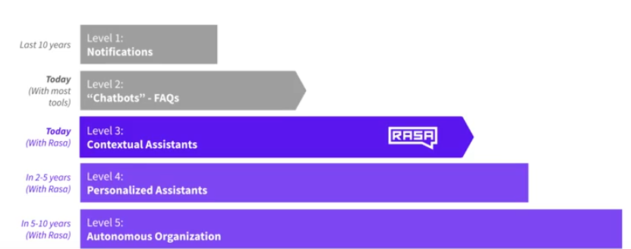
Types of Chatbots

Slide 8
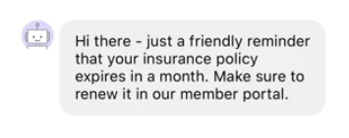
Types of Chatbots: Notification
SMS/Email assistants: Notifies you of order status.

Slide 9
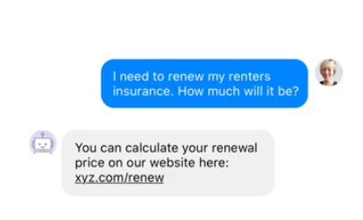
Types of Chatbots: FAQs assistants
Simple preconfigured – Differs from notification by follow up questions.
State machine – set of rules
State machines – Complex over time

Slide 10
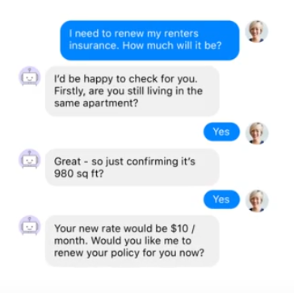
Types of Chatbots: Contextual assistants
Natural language understanding.
Understanding context
Context of conversation – recommend me a book → Harry potter → Is that fiction or non-fiction?
Handle unexpected conversation and chit chat

Slide 11
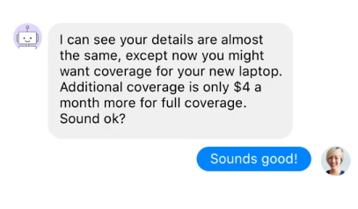
Types of Chatbots: Personalized assistants
Reviews your email/credit cards.
Remember your preferences.
Advice on insurance/investment portfolios

Slide 12
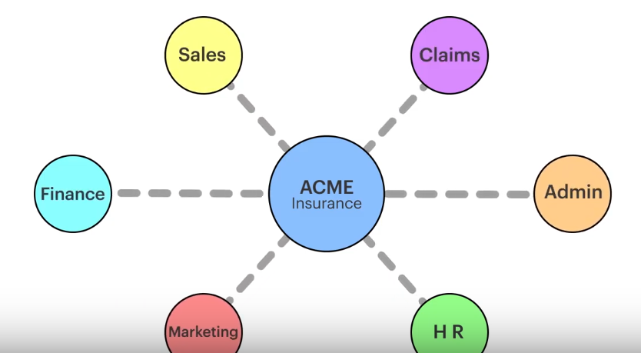
Types of Chatbots: Autonomous organization
Take over a wide portfolio.
Advice over wide variety of aspects.
Real life conversations

Slide 13
RASA
What is RASA & What can you do with it?

Slide 14
RASA
Rasa is a set of open source machine learning tools for developers for conversational AI.
TWO PARTS:
NLU: a natural language processing tool for intent classification and entity extraction.
Core: framework for machine learning based contextual decision making.

Slide 15
RASA: Architecture
Entities & Intents

Slide 16
RASA NLU: Intents and Entities
RASA NLU
Hello. My name is Dinesh.
Entity: Dinesh(Name)
Intent: Greeting

Slide 17
RASA CORE: Dialogue management & Decision making
Hi.
Next best action:
utter_ask_name: 89%
utter_greet_user: 11%
Hi, My name is Sara the chatbot. What is your name?

Slide 18
RASA: Architecture
Exercise: Review & set up health care chatbot

Slide 19
Review:
What would be building? - Covid 19: Start the development of health care bot.
Learn the fundamental of conversation design
Generate the training data for NLU

Slide 20
Review: Chatbot use case
Hi. I am looking for hospital
USE CASE:
Customer wants to find out a nearby hospital or nursing home, dentist etc.
The bot asks for his/her location, calls. After customer provides the location, the bot will look up nearest hospital but calling a service or looking up a database.
The bot responds with the closest hospital.
Sure! Can you please provide me your city name or zip code?
Charlotte
1322 North medial plaza Charlotte NC

Slide 21
Exercise: 2
Open the nlu.md file under data folder
Review the intents
Open the stories.md files under data folder
Review the stories

Slide 22
Exercise: Design process
Who will be my users?
What are their needs?
Why will they use assistant? Ex – Transfer account, confirm one time pin (Wrong use case)
Most difficult question that they will ask the bot?

Slide 23
Exercise: Data needs
Domain experts
Most common search queries on the web
Chat history or recorded call logs.
Wizard of all technique – 1:1 conversation

Slide 24
Exercise: Chatbot data needs
Who will be my users? – Patients, Users new to area & Family of patients
What are their needs? – Nursing home, hospital, dentist, specialists
Why will they use assistant?- Self, For family member, medical emergency, On the road accident etc.
Most difficult question that they will ask the bot?- Hospitals with cancer specialty or special child unit, ICU etc.
Find me a hospital in 28027 zipcode.

Slide 25
Exercise: Chatbot design flow
Cust: Hi
Bot: Hi! How can I help you?
Cust: Find me a hospital in Charlotte?
Bot: Sure. Looking
Bot: The closes hospital is at 1322 Medical Plaza drive
Cust: Thank you!
Bot: You are welcome
Cust: Hi
Bot: Hi! How can I help you?
Cust: Find me a hospital?
Bot: Sure. What is your city or zip code?
Cust: Charlotte NC
Bot: Got it. Give me a sec …
Bot: The closes hospital is at 1322 Medical Plaza drive
Cust Thank you!
Bot: You are welcome

Slide 26
Exercise: Add the questions to your chatbot
Follow steps in exercise 2 - NLU

Slide 27
Break: 2 minutes to wrap up and try
Play with more data and add more data if you like

Slide 28
Exercise: Sentence structure & entities
Exercise: Help the bot identify sentence structure and identify entities

Slide 29
Entities: Entity extraction
Why do we need it?
Fancy word for old children game – NPAT
How to tell bot to identify entities

Slide 30
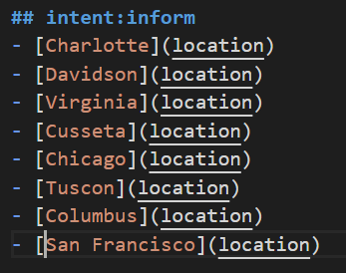
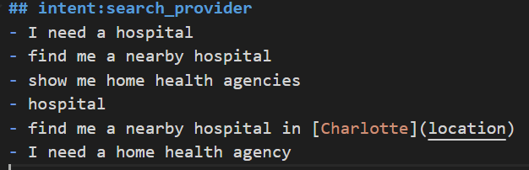
Entities: Entity extraction
[Charlotte](location)
Entity
Label: What type? location

Slide 31
Exercise: Add the entities to your bot
Follow steps in exercise 3 - NLU

Slide 32
Break: 5 minutes to wrap up and try
Play with more data and add more data if you like.
Try adding a zipcode as new enity and label it
See if you can see zipcode as identified entity in the response.

Slide 33
FAQs: How much data do I need
Start with 10-15 examples per intent.
No need to define all data for that intent. Leave some work for backend API ☺ (To be discussed in Session 2 of this meetup)
Use high quality examples only and ensure that they map to actual intent. (How’s the weather near hospital? -- XX)
High quality vocabulary (Prep bot for SATs)

Slide 34
Exercise: Architecture – processing pipeline
Exercise: How does my understand bot what user is asking?

Slide 35
Exercise: Processing Pipeline
Series of steps to understand the sentence that is used to build the model.
Tokenization
Featurization
Entity recognition
Intent classification
Response Selectors

Slide 36
Exercise: Pre-trained pipleline
Pre configured pipeline.
Custom pipeline

Slide 37
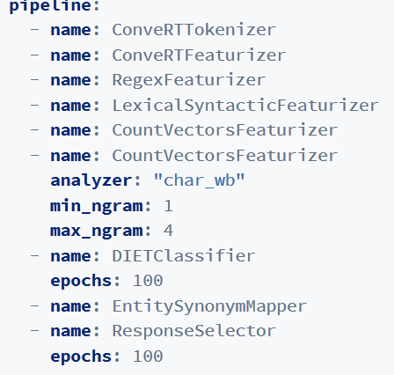
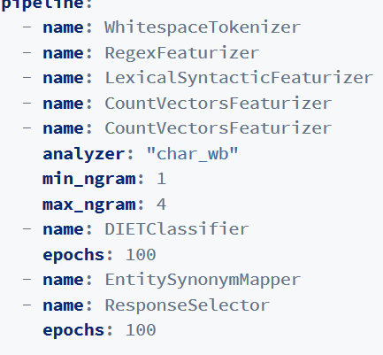
Exercise: Explore your pipeline
Pre configured pipeline
When your training data is English
Custom pipeline
When your training data is not English – Say French

Slide 38


Exercise: Word embedding/Tokens??
Required for living
Word_embedding: Association of similar text in a group.
“I WANT TO BUY AN APPLE” → DEFINED intent: get_fruit
“I WANT TO GET SOME PEARS” → PREDITCS → intent:get_fruit
ConvertRTFeaturizer: Creates a vector representation. Associates words to context.
Worldly possession to keep me happy!

Slide 39
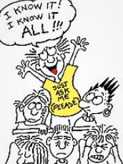
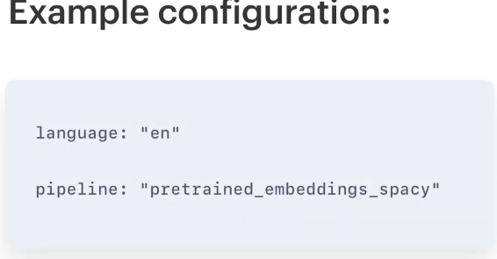
Exercise: Pre-trained embeddings

Slide 40
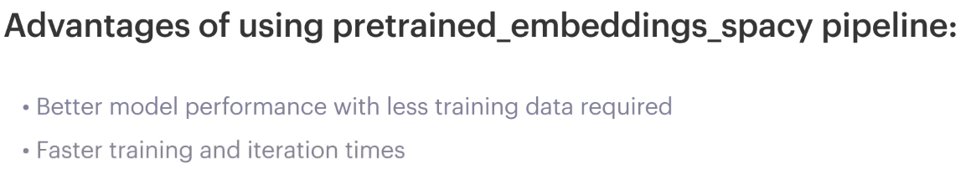
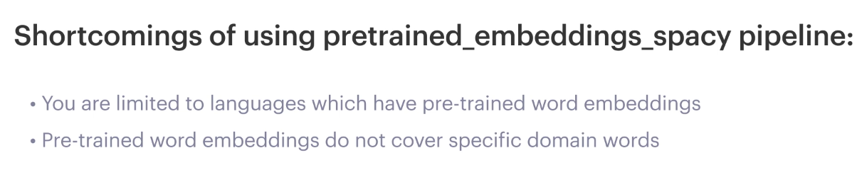
Exercise: Pre-trained embeddings

Slide 41
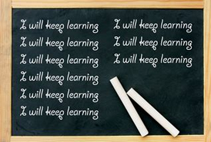
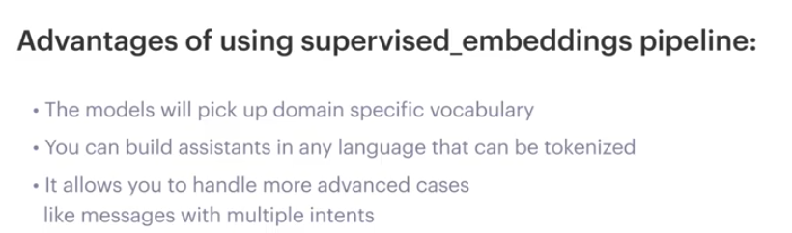
Exercise: Supervised embeddings
Learns from NLU data file
Learns about domain. Ex – Medical domain – BP, HDL, LDL(Cholesterol terms)
Needs more data compared to pre-trained data

Slide 42
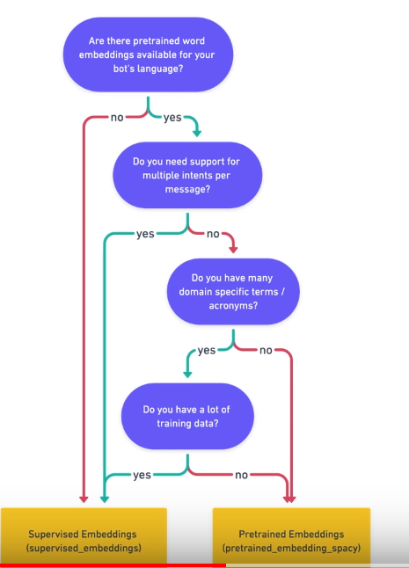
Cut the crap! Just tell me which one should I choose?

Slide 43
Exercise: Explore pipeline & play
Follow steps in exercise 4 - NLU

Slide 44
Deep Dive: Pipeline
Getting dirty in the pipeline gutter

Slide 45
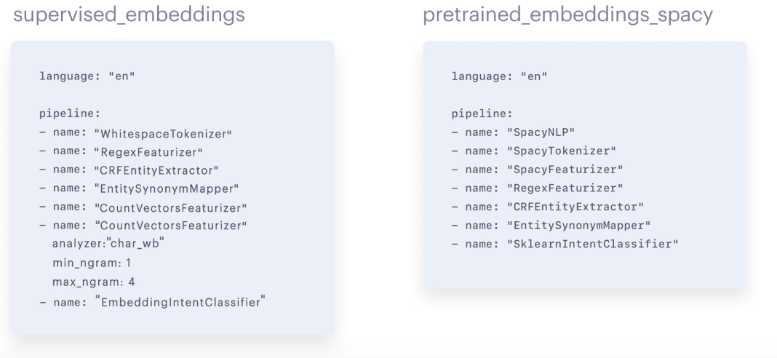
Pre-trained and Supervised models

Slide 46
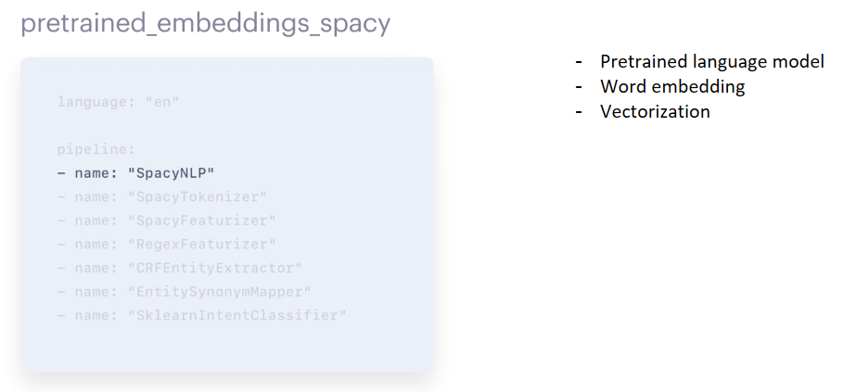
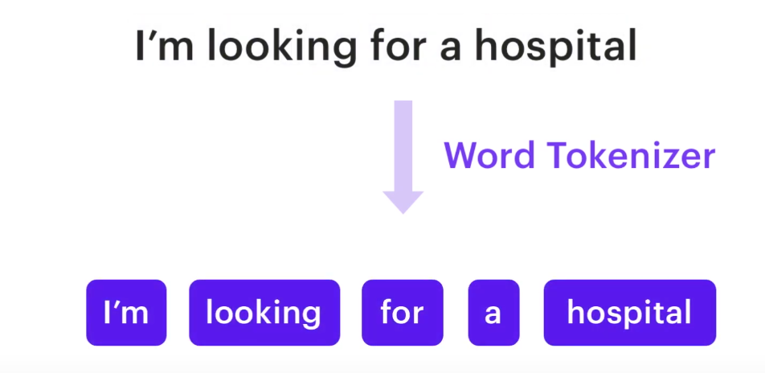
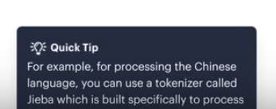
Pre-trained and Supervised models
WhiteSpaceTokenizer - Untrained
SpacyTokenizer - Pre-trained Tokenizer

Slide 47
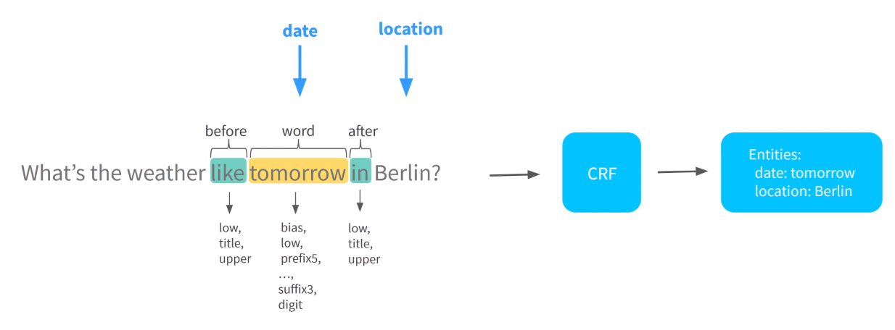
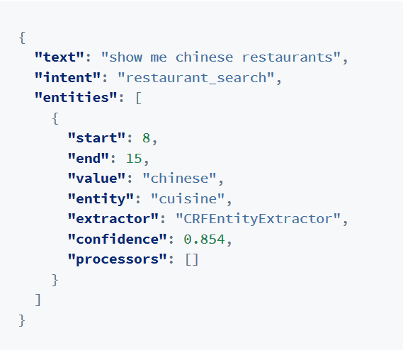
Pipeline: Entity Extractor

Slide 48
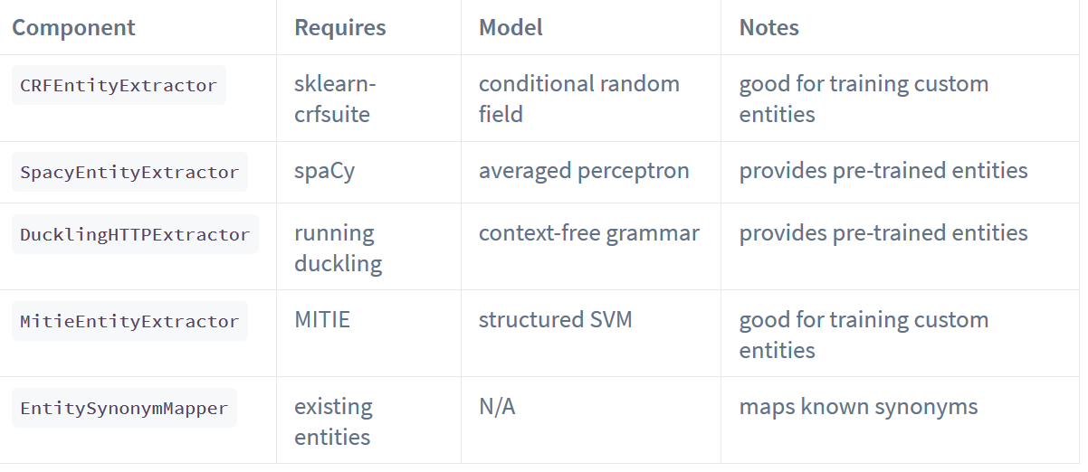
Pipeline: Entity Extractor
SpacyNLPExtractor: less samples , pre trained model.
CRFEntityExtractor: More samples

Slide 49
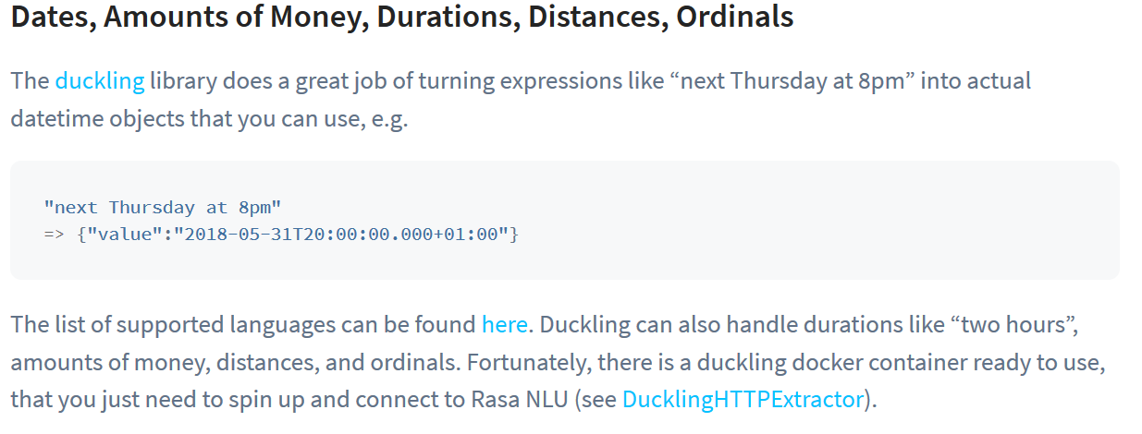
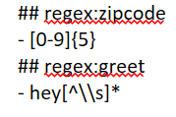
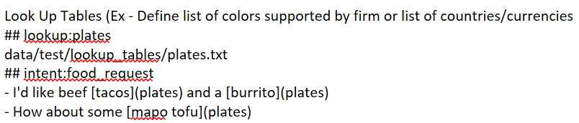
Pipeline: Entity Extractor

Slide 50


Pipeline: RegExFeaturizer
Used to provide custom Regex features
NOTE:
Must be defined before entity extractor.
Be CAREFUL on how and when to use as it can introduce a bias.
hey[^\\s]*
Intent:greet_intent
“Hey”
“hey there”
“Hey that’s not right

Slide 51


Pipeline: Intent Classification
Why: Entity extractor → Text Featurizer.
- Create features from token
In a banking domain, “balance” and “cash” are closely related and you’d like your model to capture that. You should only use featurizers from the category sparse featurizers, such as CountVectorsFeaturizer, RegexFeaturizer or LexicalSyntacticFeaturizer, if you don’t want to use pre-trained word embeddings
Why: Text Featurizer
Balance vs Balance

Slide 52
Pipeline: Intent Classification
In a banking domain, “balance” and “cash” are closely related and you’d like your model to capture that. You should only use featurizers from the category sparse featurizers, such as CountVectorsFeaturizer, RegexFeaturizer or LexicalSyntacticFeaturizer, if you don’t want to use pre-trained word embeddings
Pre- trained:
The advantage of using pre-trained word embeddings in your pipeline is that if you have a training example like: “I want to buy apples”, and Rasa is asked to predict the intent for “get pears”, your model already knows that the words “apples” and “pears” are very similar. This is especially useful if you don’t have enough training data. We support a few components that provide pre-trained word embeddings:
MitieFeaturizer
SpacyFeaturizer
ConveRTFeaturizer
LanguageModelFeaturizer

Slide 53
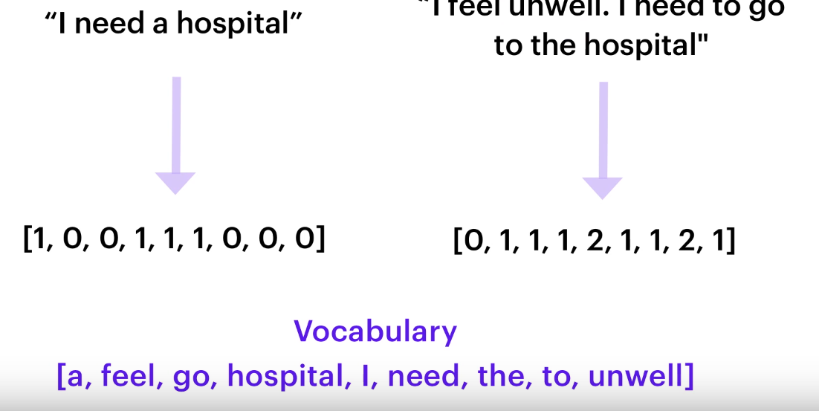
Pipeline: Intent Classification
Recall the ngrams exercise 4

Slide 54
Does the order matter?
Yes. Each component is used as input to another component.
Should I worry about class imbalance and what exactly is class imbalance?
When you have more when menu more training data for a particular intent then you can introduce an imbalance.
Yes an imbalance can be introduced and it can impact your model however in in RASA can provide you some started is to handle this imbalances.
Does the punctuation in mitrany example matter?
Punctuation such as, full stop apostrophe are not exactly tokenized so they don't really matter
is intent classification and entity extraction are case sensitive?
Entity extraction is case sensitive however intent classification is not.
What if I want to extract entity from single words?
One word extraction are challenging. Best way to deal with them is to create an informant ENT and provide one line entity extraction.
can I specify more than one in 10 classification model?
Technically yes but you're not going to gain any points for doing that.
How do I deal with typos?
Typos cannot be avoided. What you can do is implement a custom spell checker in your pipeline. second thing you can do is add some example with typos.

Slide 55
Natural Language Processing Workshop
Session 2

Slide 56
Tradition - Dialogue management
State 0
State 2
State 1
Traditional : State/Rule based

Slide 57
Issues with rule based
Human nature – drift away or digress
Overtly complex
Every scenario demands a new rule
Bad user experience

Slide 58
RASA CORE: Dialogue management brain
Where is the nearest Walmart?
122 Walmart dr. You may need to hurry as Walmart closes in 30 minutes. If you want, I can take online orders for you and you can pick up at curbside before the store closes
Perfect! I need a loaf of bread, 2% gallon milk and a dozen eggs.
Your order is placed. You can pick up your order at curbside. Your order #is 12834

Slide 59
RASA CORE: Dialogue management brain
Uses machine learning
Can creates multiple different scenarios from a given set of scenarios
Handles unexpected dialogue flows
Provides complex

Slide 60
Exercise: Explore Stories
Follow steps in Session-2/exercise 1
Explore data/stories.md

Slide 61
In/Out – User story
Consists of 3 main parts
Story name
Intention name
Actions
## User greeting story
*greet
- utter_greet_user
- utter_ask_name
## facility search story
*greet
- utter_greet
*search_provider(“facility_type”:location)
- utter_ask_zipcode

Slide 62
In/Out – User story
Story names – Optional & descriptive
Intent names must exist in nlu.md
Action – 2 types: Utterances & Cutsom actions

Slide 63
Exercise: Add a story
Follow steps in Session-2/exercise 1
Add a story for searching a hospital

Slide 64
RASA Core – Domain/Slots/Actions
Domain – Chatbot Universe
Slots – Context holder
Custom action – Custom code/API/web service

Slide 65
RASA Core – Domain
BOT
Intents
Decision: How to respond?
Memory: What to hold for context?
Responses

Slide 66
Exercise: Explore Domain
Follow steps in Session-2/exercise 2
Find the components/universe of bot.

Slide 67
RASA: Exploring the Action guts
Respond to user
External API calls
Query a database
Custom code or transformation etc.
Utterance actions: utter_xxx
Retrieval actions: respond_xxx
Custom actions: some code
Default action: action_listen, action_restart
Reference: https://rasa.com/docs/rasa/core/actions/#actions

Slide 68
Exercise: Explore Custom actions
Follow steps in Session-2/exercise 3
Review how to write a custom hello world action.

Slide 69
RASA: Slots
Works as assistants meomory
Synonymous to variables in programming language
Saved as key:value pair
For example, if your user has provided their home city, you might have a text slot called home_city. If the user asks for the weather, and you don’t know their home city, you will have to ask them for it. A text slot only tells Rasa Core whether the slot has a value. The specific value of a text slot (e.g. Bangalore or New York or Hong Kong) doesn’t make any difference
Reference:https://rasa.com/docs/rasa/core/slots/

Slide 70

RASA: Slots
Remind about extracted values
Add slots in domain
Types of slots:
Text – missing/decision making. Value not matters
Bool – must have value
Categoriacl – presence and actual value matters(low. Medium, high)
Float: presence and value matters
List – (buttons example)
Unfeaturized – presence and value has o influence

Slide 71
Exercise: How to use slots
Follow steps in Session-2/exercise 4

Slide 72
Rasa: Policing the policies
Policy:
Helps handle stupid questions, chit chats
Helps bring back conversation to bot flow
Alternate flow when cannot ascertain the need after few tries
- Ex - Transfer to customer care after 3 failed attempts
Siri, do you have parents?
The weather here is good but … blah blah.

Slide 73
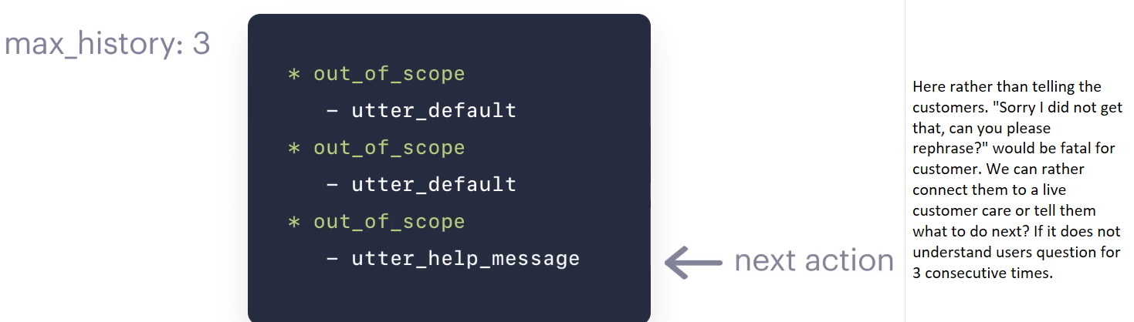

Slide 74
Rasa: Stories using ML
Data Augmentation:
Rasa creates long stories from existing stories.
Handles unexpected flow not defined by user.
Longer stories helps reduce the max history.

Slide 75
Thanks
Greet
Bye
New Story 3
*greet
Utter_greet
*thanks
Utter_you_are_welcome
*bye
Utter_goodbye
New Story 1
*greet
Utter_greet
*thanks
Utter_you_are_welcome
New Story 2
*greet
Utter_greet
*bye
Utter_goodbye

Slide 76
Rasa: Data Augmentation
Enable: Using command line - -augmentation 20
Lazy man’s tool – Low vs Higher number of stories
The augmentation =20 will create 20 *10(number of sampled stories) = 200 stories
Higher augmentation factor means more stories → Higher training times → Better performance
Use higher number when you have less stories.
Use lower number when you have many stories

Slide 77
Rasa: Types of policies
Memoization policy
Mapping Policy
Keras Policy
Form Policy
Fallback policy

Slide 78
Rasa: Types of policies
Memoization policy
- It tries to memorize the user text from sample and if sample matches then it returns a confidence 1.0 else it returns none. This is the simplest of the policy. Always used with other policies. Can set max_history from deafult 5 to higher and set Priority.

Slide 79
Rasa: Types of policies
Mapping policy
This policy is used to map intent to an action. An intent can be mapped to a atmost one action. The bot runs the mapped action once and then returns to user listen mode. This policy is used in addition to other policy. It does not affect the flow of dialogue or user history.
For example, if a user asks “Are you a bot?” off-topic in the middle of the flow, you probably want to answer without that interaction affecting the next action prediction. A triggered custom action can do anything, but here’s a simple example that dispatches a bot utterance and then reverts the interaction
.

Slide 80
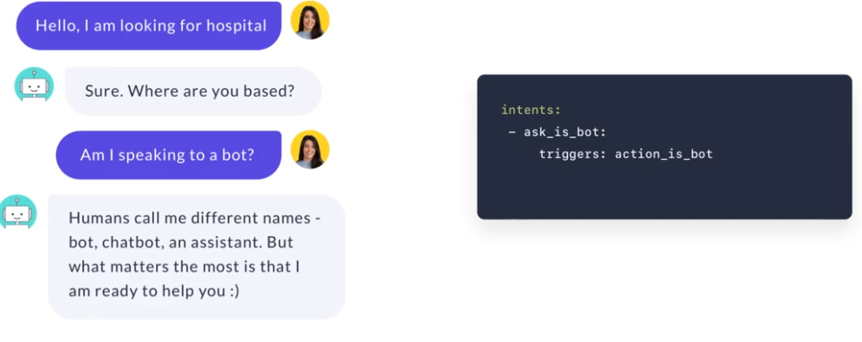

Slide 81
Rasa: Types of policies
keras policy
Helps predict the next action
What was the last action
What entities and intent were predicted for the current user input
What slots are set before and after.
Uses ML to learn from your stories and handle challenging questions
Uses RNN and replaces default LSTM architecture.

Slide 82
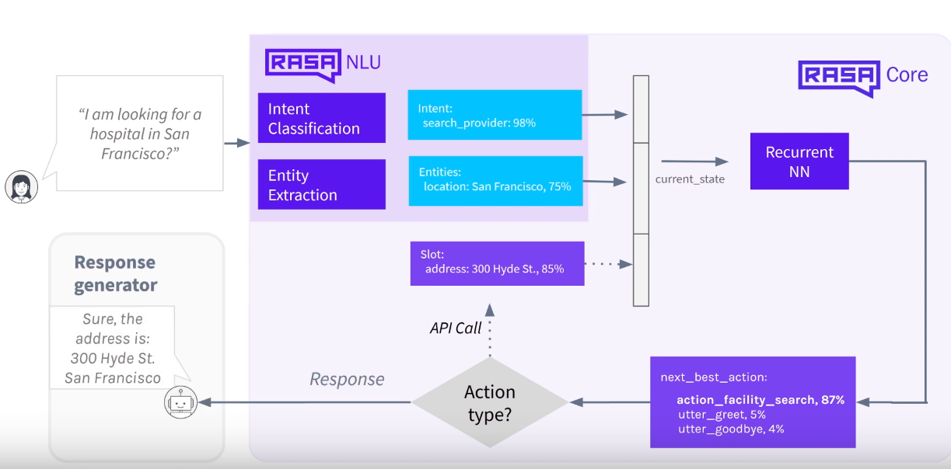

Slide 83
Rasa: Types of policies
Form Policy:
In cases where the bot needs to collect specific information before it can get you a specific information then you need to implement form policy. You may ask that you can use slots to save a information but in cases where you need to save a lot of different information then forms is better approach because with slots you need to write a lot of stories to get a happy path. A form policy can trigger a form action and it can predict the next information it needs to ask to get the job done.
Fallback policy: The name suggest fallback is just like hanging an exception when you are bought is not able to predict the next section you can always rely in a fall back to give a standard response. You can configure a threshold values after which your fallback policy will be triggered and fallback action will be called.

